Slide 1
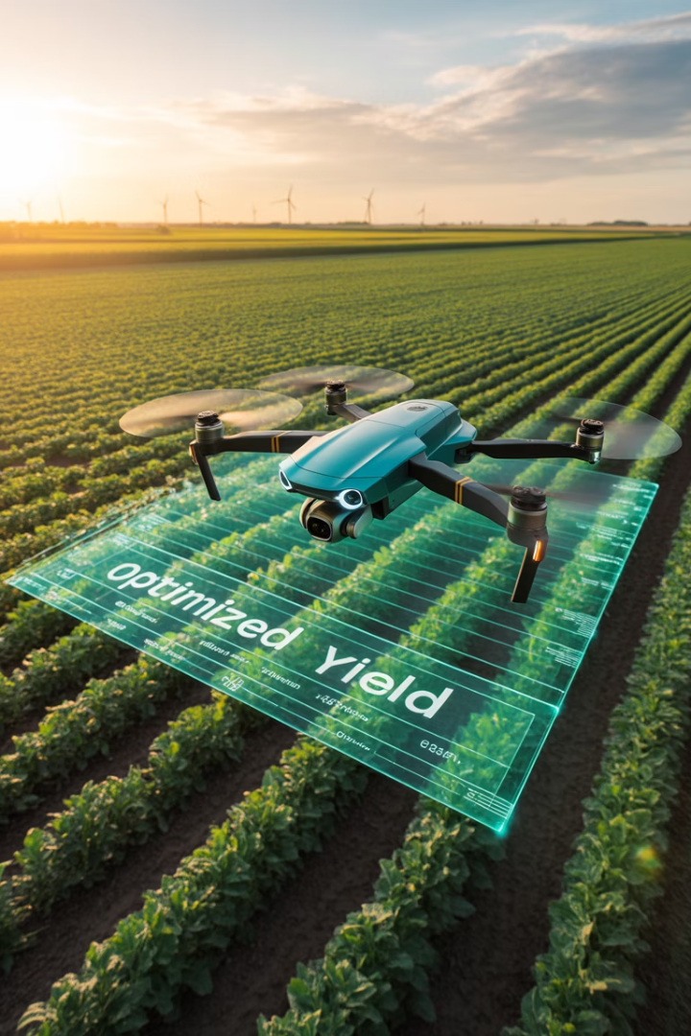
AI in Agriculture: Cultivating the Future
Transforming farms with intelligent technologies
Addressing global food challenges through data-driven agriculture
by Michael Garcia, Hashim Sayed Hoosini, Miguel

Slide 2
Why Agriculture Needs AI
Growing Challenges
AI Solutions
Rising global food demand
Enhanced productivity
Climate change threatens yields
Data-driven decision making
Severe labor shortages
Precise resource management
Fresh water shortage
Smart irrigation System
Enviromental chemical footprint
VRT Variable Rate Technology

Slide 3










Key Agricultural Pain Points
AI Decision Support
Faster, smarter farming choices
Automation Needs
Labor shortages require tech solutions
Resource Waste
Excessive water and chemical use
Disease & Pests
Rapid spread damages crops
Yield Prediction
Inaccurate forecasting hurts planning

Slide 4
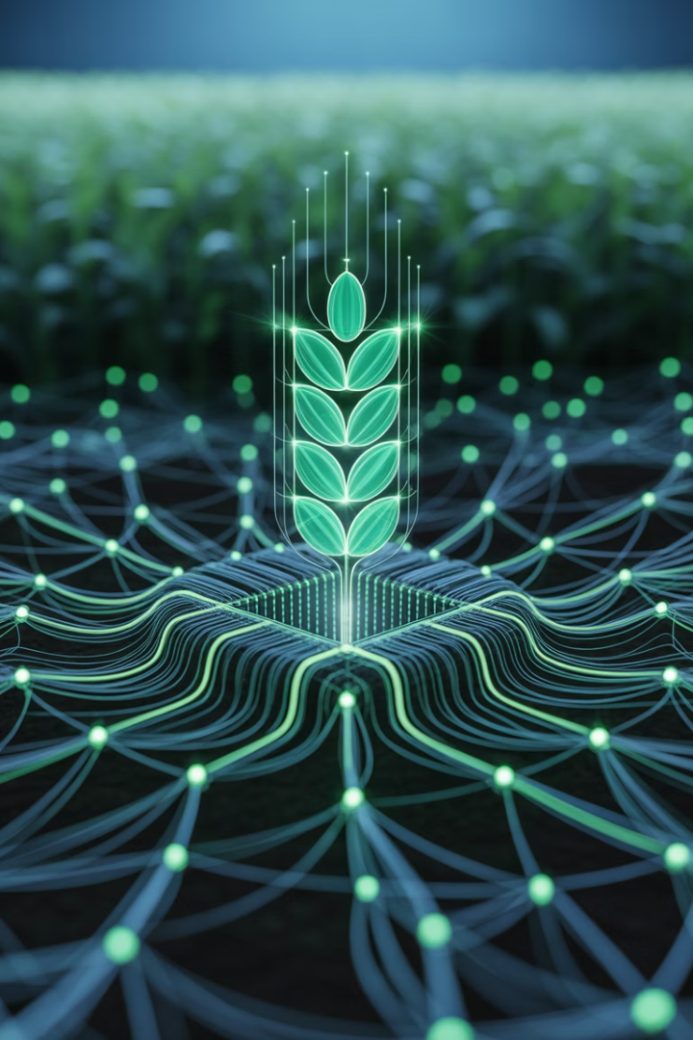




AI Techniques in Agriculture
Computer Vision (CNNs)
Analyzes drone/satellite images for crop health
Machine Learning
Predicts weather patterns and pest outbreaks
IoT + AI
Soil sensors provide real-time field data
Natural Language Processing
Processes and analyzes field reports

Slide 5
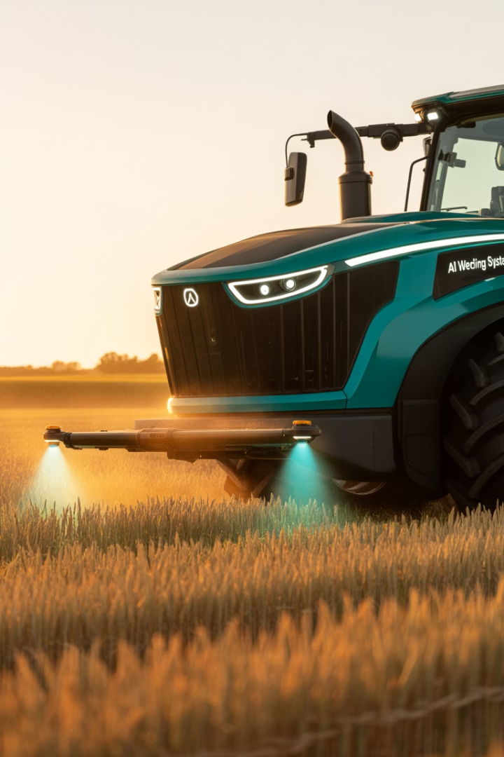




Innovative AI Applications
Smart Tractors
Disease Detection
Weather Integration
John Deere's autonomous equipment
Plantix app identifies 400+ plant diseases
IBM Watson guides planting decisions
Results
20% higher yields, 30% less pesticides

Slide 6
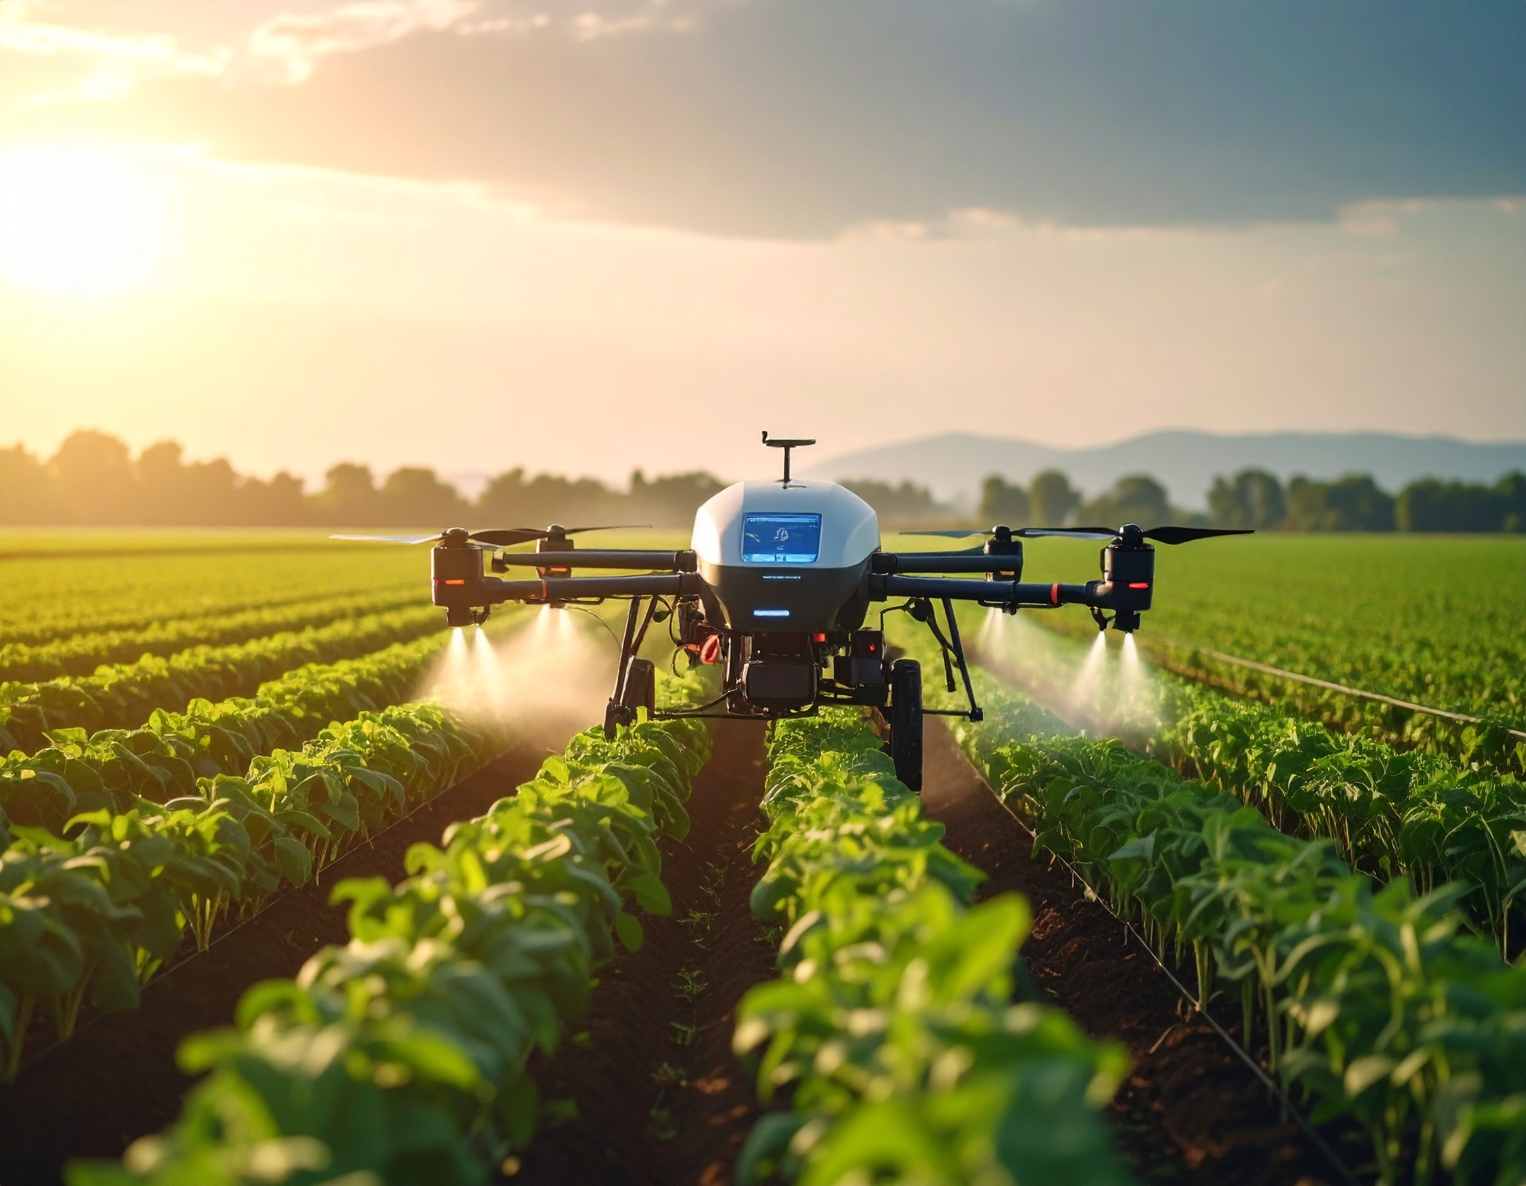
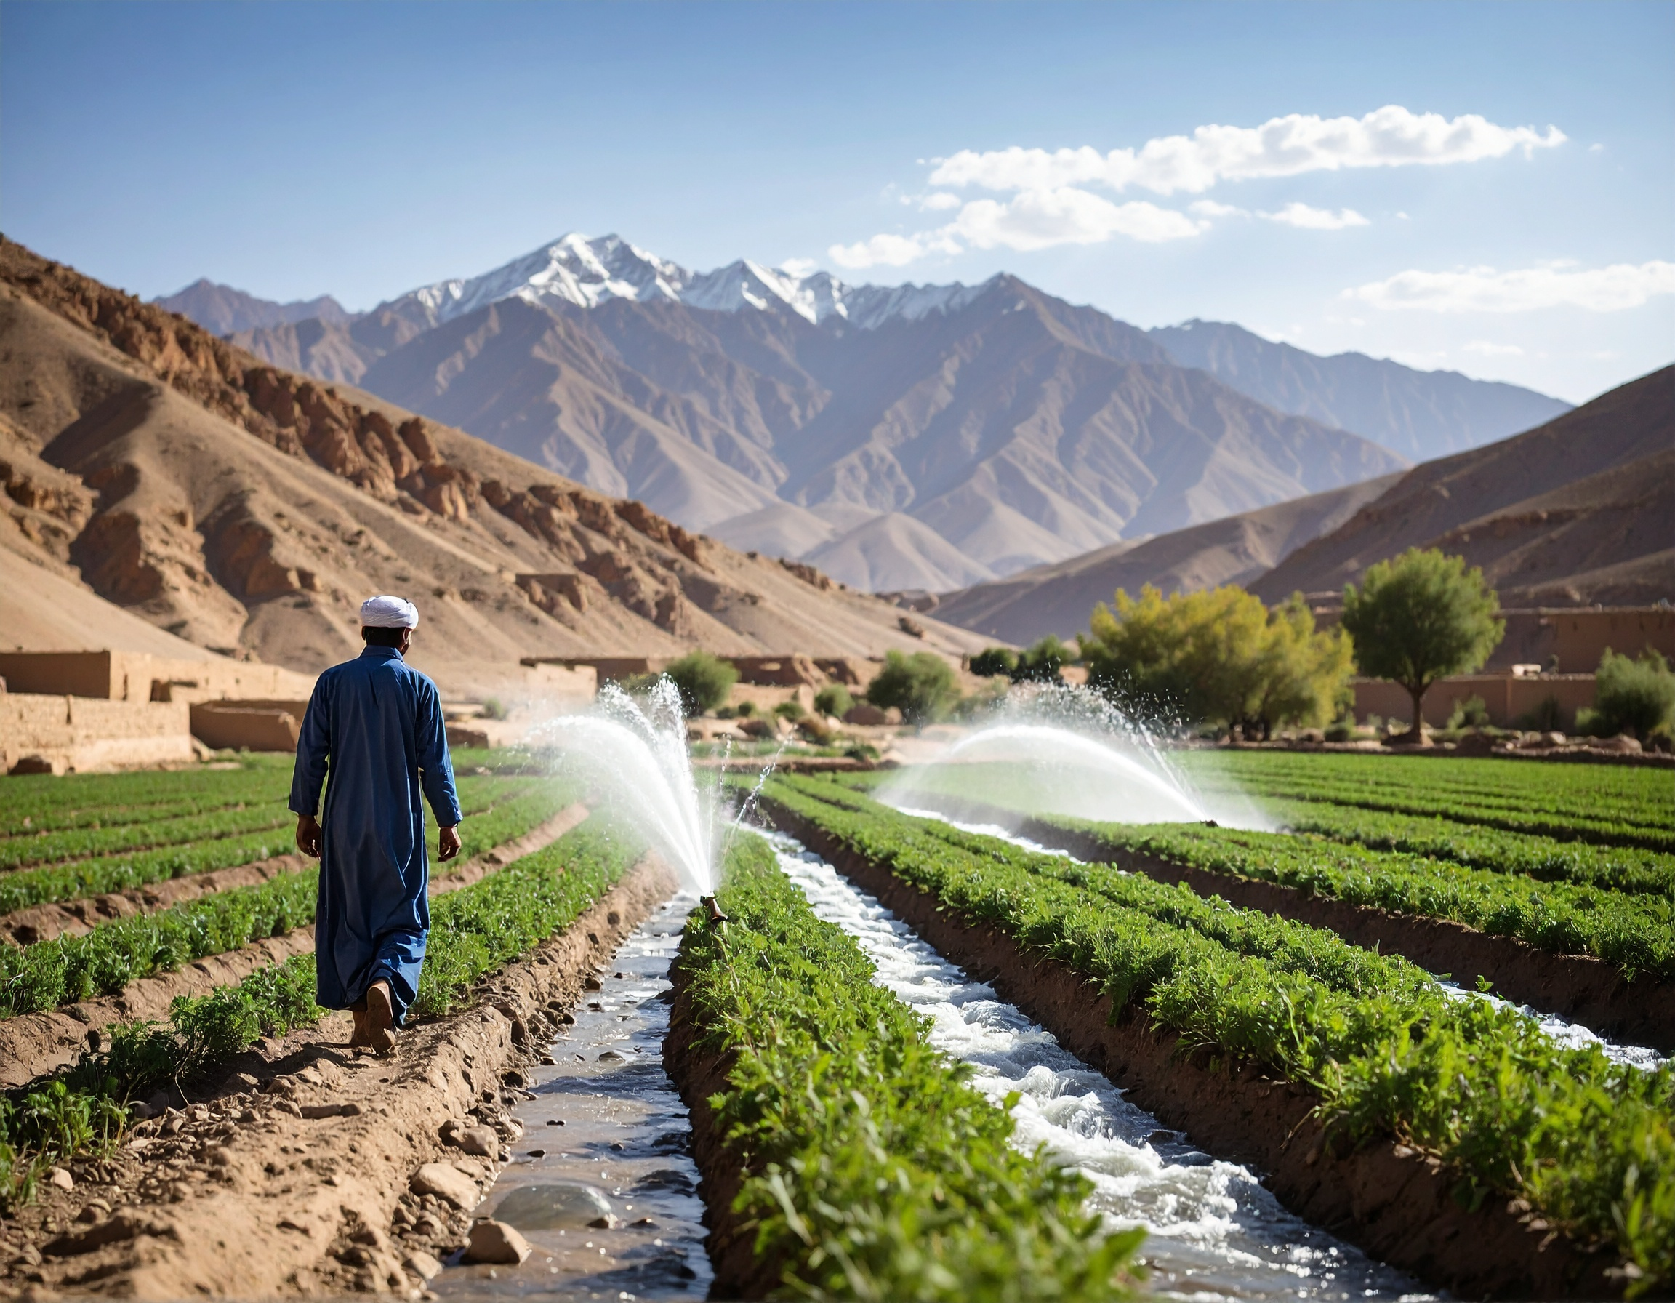
Smart Irrigation System
AI- Driven precision agriculture cut water usage by up to 25%.
Automated systems lead to long- term cost saving for farmer.
Precision irrigation addresses global freshwater insufficiency challenges.

Slide 7
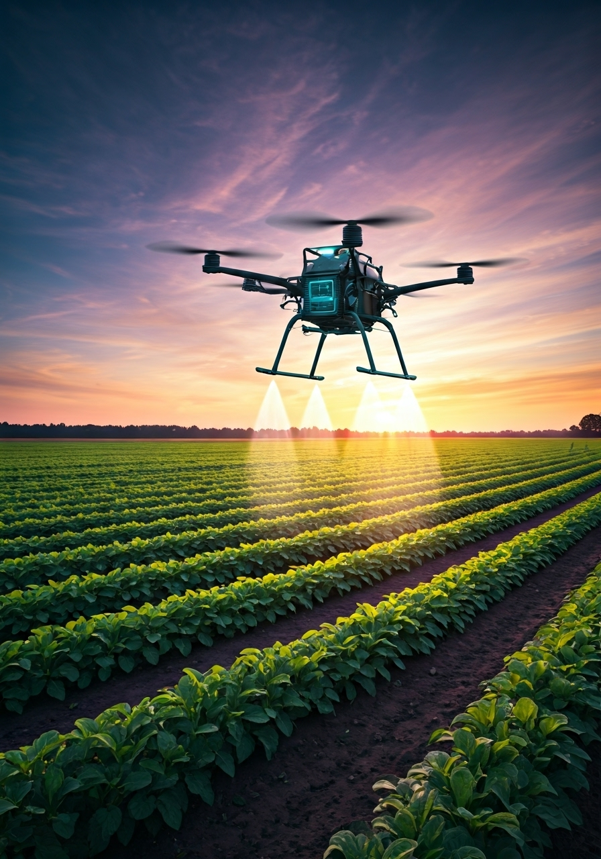
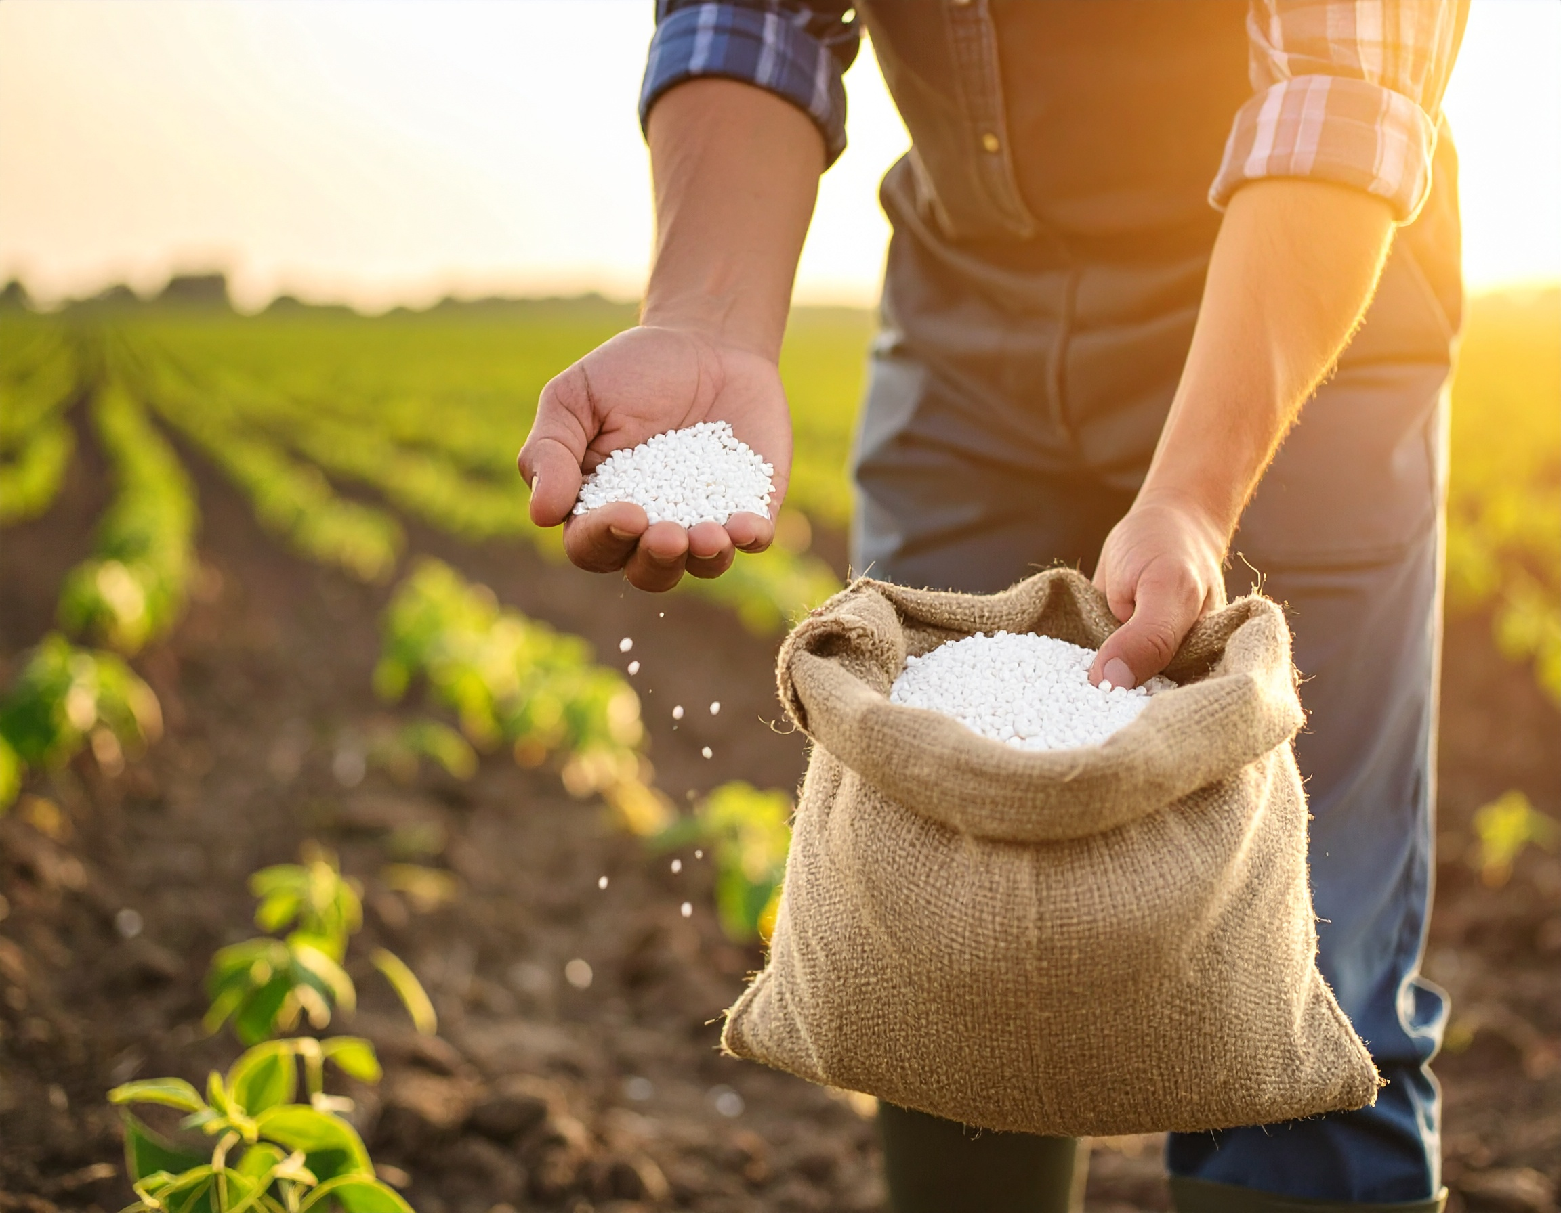
Variable Rate Technology (VRT)
Adjustable to Nature , reduce the seeds, and fertilizer, better quality produce.
Avoid over application nitrate, prevent water pollution help to conserve natural resources.
VRT make it easy to trace everything applied to fields.

Slide 8
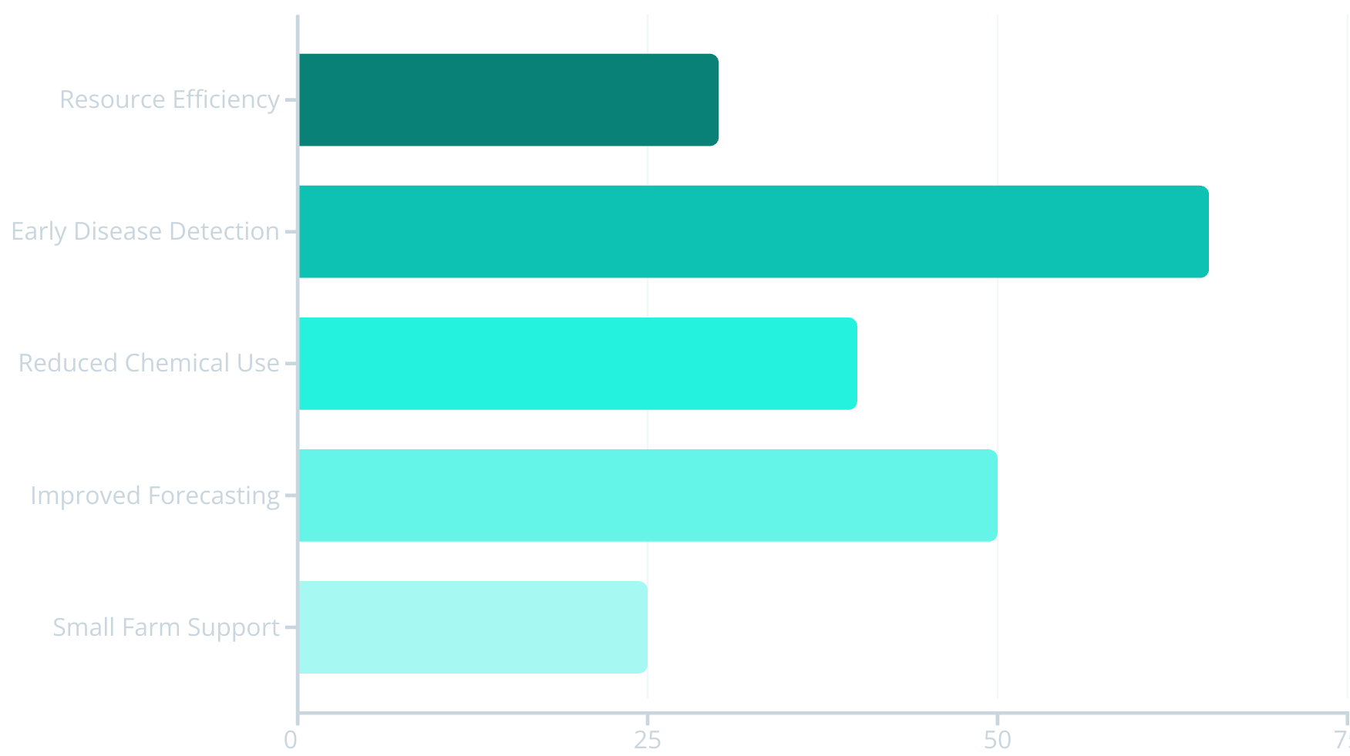
Impact & Benefits

Slide 9








Challenges to Overcome
High Costs
Connectivity
Smart tractors exceed $500K
Limited rural internet access
Data Privacy
Training Gaps
Farm data ownership concerns
Farmers need AI education

Slide 10
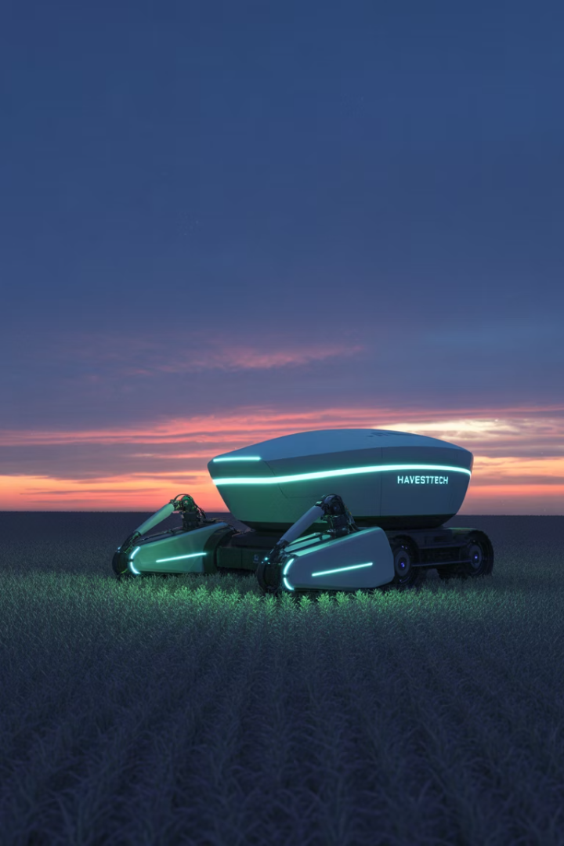
The Future of Agricultural AI
Robotic Harvesting
Agrobot's strawberry pickers revolutionize labor-intensive crops
Edge AI Systems
Real-time pest alerts without internet connectivity
Climate Adaptation
AI predicts optimal drought-resistant crops for changing conditions
Global Access
Low-cost mobile AI brings technology to all farm sizes

Slide 11
References & Acknowledgments
IBM Watson Agriculture
From Seed to Server: The Evolution of Modern Agriculture
John Deere AI
Plantix by PEAT
UN & FAO reports
Microsoft FarmBeats
Keymakr.com
Alcimed.com
AI Environmental Monitoring for Better Crop Yields | Sairone

